Slide 1
PanDAS and Web GUI Automation
Gokkul Nath T S (EGOKKUL)

Slide 2
agenda
Pandas : Python Data Analysis Library
Web GUI Automation :
selenium : Selenium automates browsers interactions.
CLI Automation :
Understanding Expect :
pexpect : Pure Python Expect-like module
Web API Library:
requests :
paramiko : Remote SSH and Execute

Slide 3
Pandas
Pandas is free, an open source software, Python library which is built on top of NumPy of Python for Data Processing optimized especially for tabular data.
Pandas is used for extensively used for data manipulation, analysis and cleaning.
Using Pandas, we accomplish five typical steps in the processing and analysis of data, regardless of the origin of data.
Load
Prepare
Manipulate
Model
Analyze
Using Python pandas, you can perform a lot of operations with series, data frames, missing data, group by etc.

Slide 4
Data which is suitable for pandas
pandas is well suited for different kinds of data, such as:
Tabular data with heterogeneously-typed columns Ordered
unordered time series data
Arbitrary matrix data with row & column labels
Un-labelled data
Any other form of observational or statistical data sets

Slide 5
Key features of pandas
Fast and efficient DataFrame object with default and customized indexing.
Tools for loading data into in-memory data objects from different file formats.
Data alignment and integrated handling of missing data.
Reshaping and pivoting of date sets.
Label-based slicing, indexing and sub setting of large data sets.
Columns from a data structure can be deleted or inserted.
Group by data for aggregation and transformations.
High performance merging and joining of data.
Time Series functionality

Slide 6
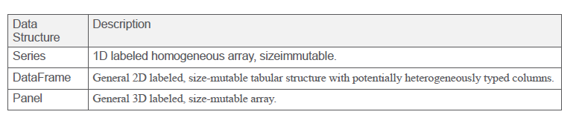
Pandas: Data Structures
Pandas deals with the following three data structures
Series
DataFrame
These data structures are built on top of Numpy array and Pandas computes in-memory with same datatypes of one columns than it’s are fast.
DataFrame is a container of Series, and Panel is a container of DataFrame.
All Pandas data structures are value mutable (can be changed) and except Series all are size mutable. Series is size immutable.

Slide 7
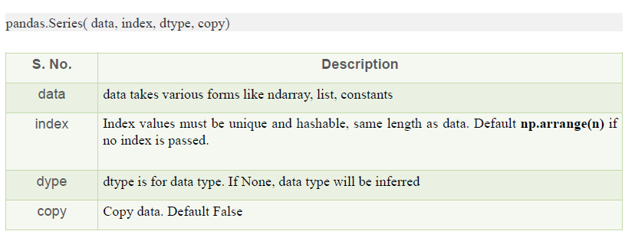
Series
Series:
Series is a one-dimensional array like structure with homogeneous data. For example, the following series is a collection of integers 10, 23, 56..
Series can only store Homogeneous data
They are Size Immutable, but Values of Data Mutable
A series can be created using various inputs like −
Scalar value or constant
Python Dictionary Object
Python List Object
NumPy NdArray
A series can be created using various inputs like −
NumPy NdArray
Python List Object
Python Dictionary Object
Scalar value or constant

Slide 8
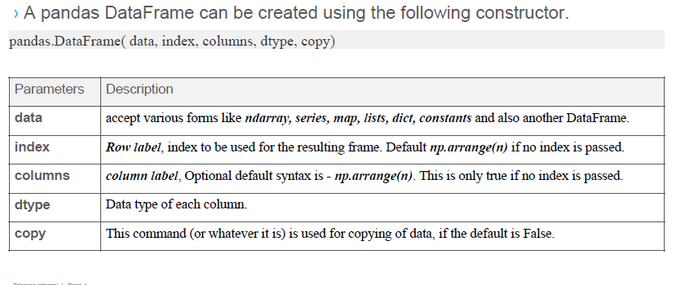
Dataframe
Data is aligned in a tabular fashion in rows and columns.
Features:
Potentially columns are of different types
Size and elements are mutable
It has labeled / index axes (rows and columns)
Arithmetic operations can be preform on rows and columns

Slide 9
Web GUI Automation using Selenium
Selenium:
Selenium is a Functional Automation tool for Web applications.
Selenium is an open source tool (No cost Involved in it).
Selenium supports the languages like HTML, Java, PHP, Perl,Python, Ruby and C#.
It supports the browsers like IE, Mozilla Firefox, Safari, Google Chrome and Opera.
It supports the operating systems like Windows, Linux and Mac.
It is very flexible when compared to QTP and other functional tools, because it supports multiple languages.

Slide 10
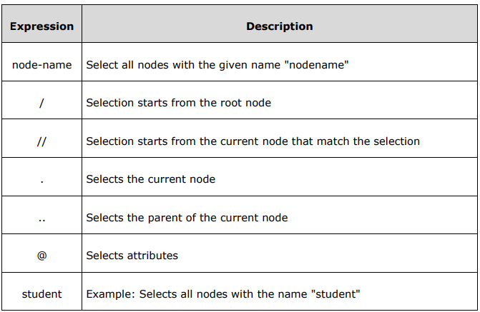
XPath Expression
An XPath expression generally defines a pattern in order to select a set of nodes.
XPath specification specifies seven types of nodes which can be the output of execution of the XPath expression.
• Root • Element • Text • Attribute • Comment • Processing Instruction • Namespace

Slide 11
Xpath
Absolute XPath : It is the direct way to find the element, but the disadvantage of the absolute XPath is that if there are any changes made in the path of the element then that XPath gets failed
e.g. html/body/div/div/div[2]/div[1]/table[1]/td[2]/tr[2]
Relative Xpath: For Relative Xpath the path starts from the middle of the HTML DOM structure. It starts with the double forward slash (//), which means it can search the element anywhere at the webpage.
e.g. //input[@id=‘some_id’]
Basic Xpath- XPath expression select nodes or list of nodes on the basis of attributes like ID , Name, Classname, etc. from the XML document as illustrated below.
e.g. xpath=//*[@name=‘some_name’]

Slide 12
Contains-Contains() is a method used in XPath expression. It is used when the value of any attribute changes dynamically, for example, login information.
e.g. //*[contains(@type,’sub’)]
Using OR & AND- In OR expression, two conditions are used, whether 1st condition OR 2nd condition should be true. It is also applicable if any one condition is true or maybe both. Means any one condition should be true to find the element. In AND expression, two conditions are used, both conditions should be true to find the element. It fails to find element if any one condition is false.
e.g. //input[@type=‘name’ and @name=‘some_name’]
//input[@type=‘name’ and @name=‘some_name’]
Starts-with Function- Start-with function finds the element whose attribute value changes on refresh or any operation on the webpage. In this expression, match the starting text of the attribute is used to find the element whose attribute changes dynamically. You can also find the element whose attribute value is static (not changes).
e.g. //label[starts-with(@id,’message’)]
Text() - In this expression, with text function, we find the element with exact text match as shown below. In our case, we find the element with text "UserID".
e.g. //td[text()=‘SomeText’] or //input[contains(text(),’sometext’)]

Slide 13
Handling dynamic element
Basic XPATH
//tagname[@attribute=‘value’]
e.g. xpath=//[@name=‘some_name’]
Contains()
e.g. //[contains(@type,’sub’)]
Start-with function
e.g. //label[starts-with(@id,’message’)]
Text()
//input[contains(text(),’sometext’)]

Slide 14
CLI Automation using pexpect
Pexpect is a Python module for spawning child applications and controlling them automatically.
Pexpect can be used for automating interactive applications such as ssh, ftp, passwd, telnet, etc.
It can be used to a automate setup scripts for duplicating software package installations on different servers. It can be used for automated software testing.
Two main interfaces to the Pexpect system:
run() : executes a given program and then returns the output
The spawn class : we can spawn a child program then interact with it by sending input and expecting responses (waiting for patterns in the child’s output).

Slide 15
Python Resources
Python Weekly : https://www.pythonweekly.com/
Reddit:
r/python : https://old.reddit.com/r/Python/
r/learnpython: http://old.reddit.com/r/learnpython
r/coolgithubprojects: Link
Full Stack Python : https://www.fullstackpython.com/
Dan Baders Python Blog : https://dbader.org/
Twitter:
Kenneth Reitz @kennethreitz
Raymond Hettinger @raymondh
PyCon India @pyconindia
BangPypers @__bangpypers__

Slide 16
subprocess: Spawning Additional Processes
Purpose Start and communicate with additional processes.
The subprocess module defines one class, Popen, and a few wrapper functions that use that class. The constructor for Popen takes arguments to set up the new process so the parent can communicate with it via pipes
Methods:
Call() : takes command as a list of strings. And when shell argument is set to a true value , subprocess spawns an intermediate shell process, which then runs the command.
check_output() is used to capture the output for later processing
Note: API for working on UNIX and Windows is roughly the same, but the underlying implementation is slightly different

